Slide 1
IBM QUANTUM OPEN SCIENCE PRIZE 2022
Benjamin Tan, Chong Hian Chee, Pooja Jayachandran
April 15, 2023

Slide 2
Contents
Kagome Lattice Cell Problem
Proposed Quantum Algorithm
Variational Quantum Eigensolver
Strategies to reduce errors
Implementation Results
Using 16-Qubit ibmq_guadalupe
Discussion
Scalability of Algorithm
Conclusion

Slide 3
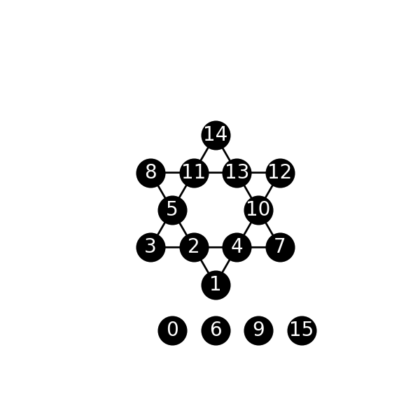
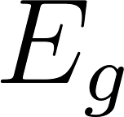
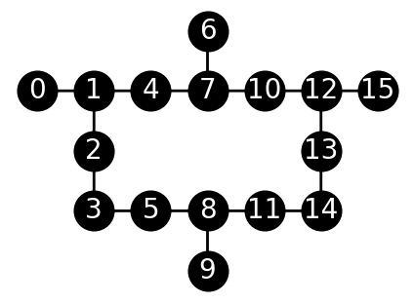
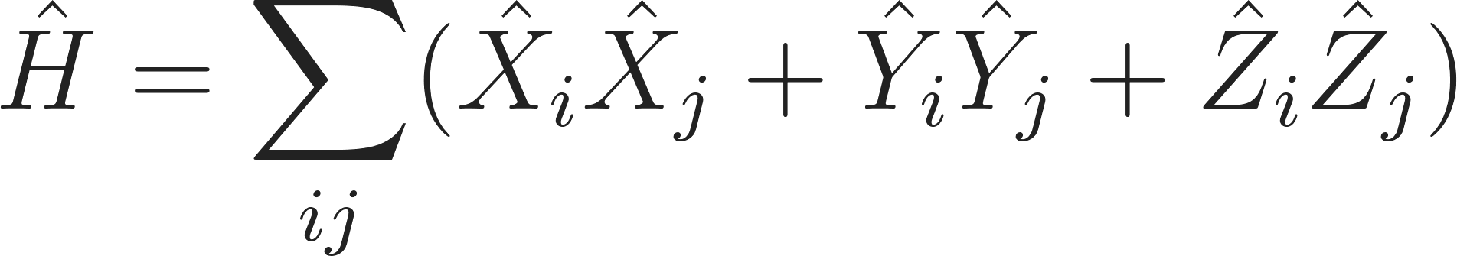
Kagome Lattice Cell Problem
Goal:
Find the Ground State Energy of Kagome Lattice Cell using 16-Qubit ibmq_guadalupe.
12-Site Kagome Lattice Cell
16-Qubit ibmq_guadalupe
Unused Site Labels in Cell.

Slide 4
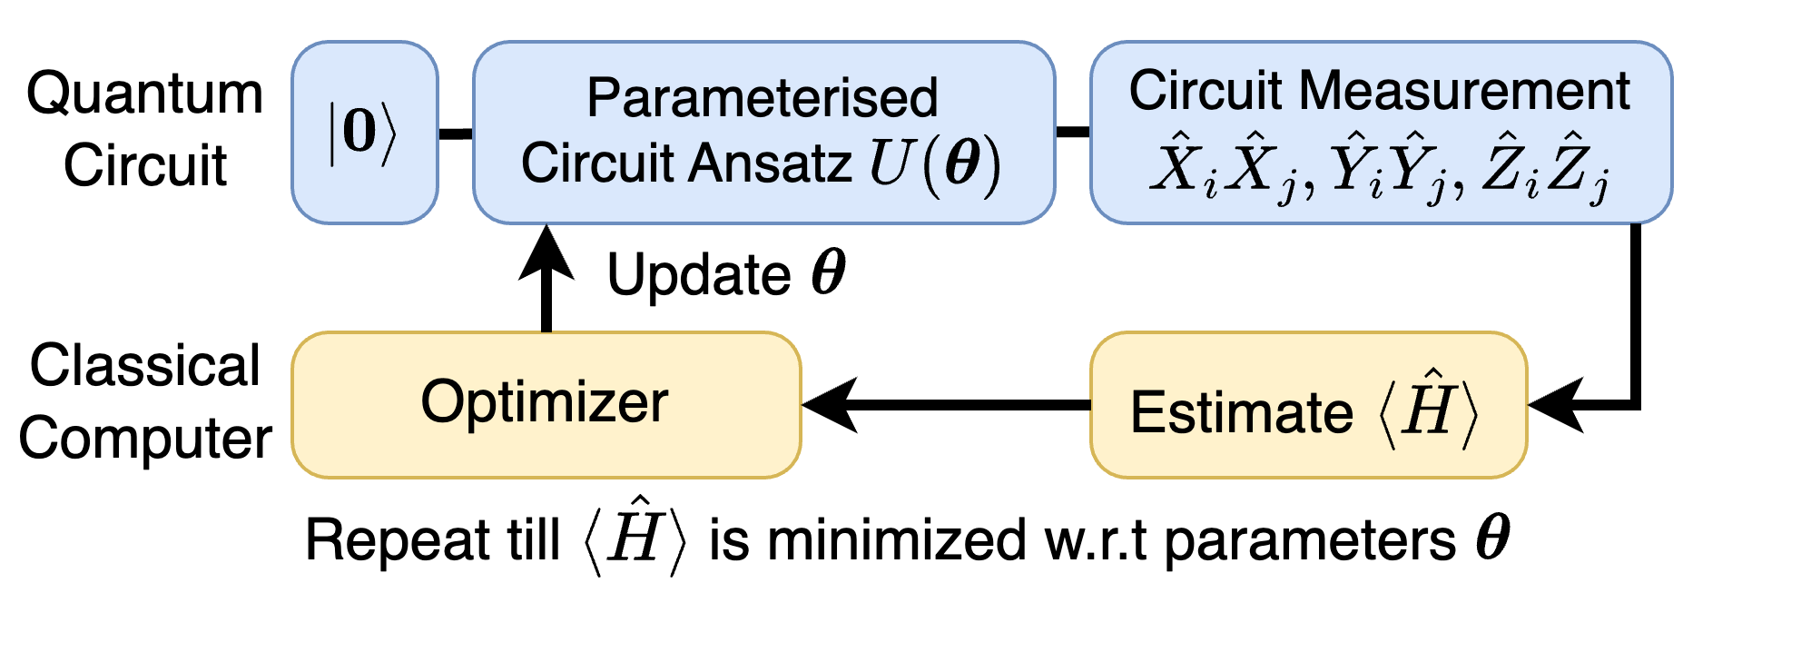
Proposed Quantum Algorithm
Objective:
Estimate
using Variational Quantum Eigensolver (VQE). (Physics Reports 986, 1 (2022))

Slide 5
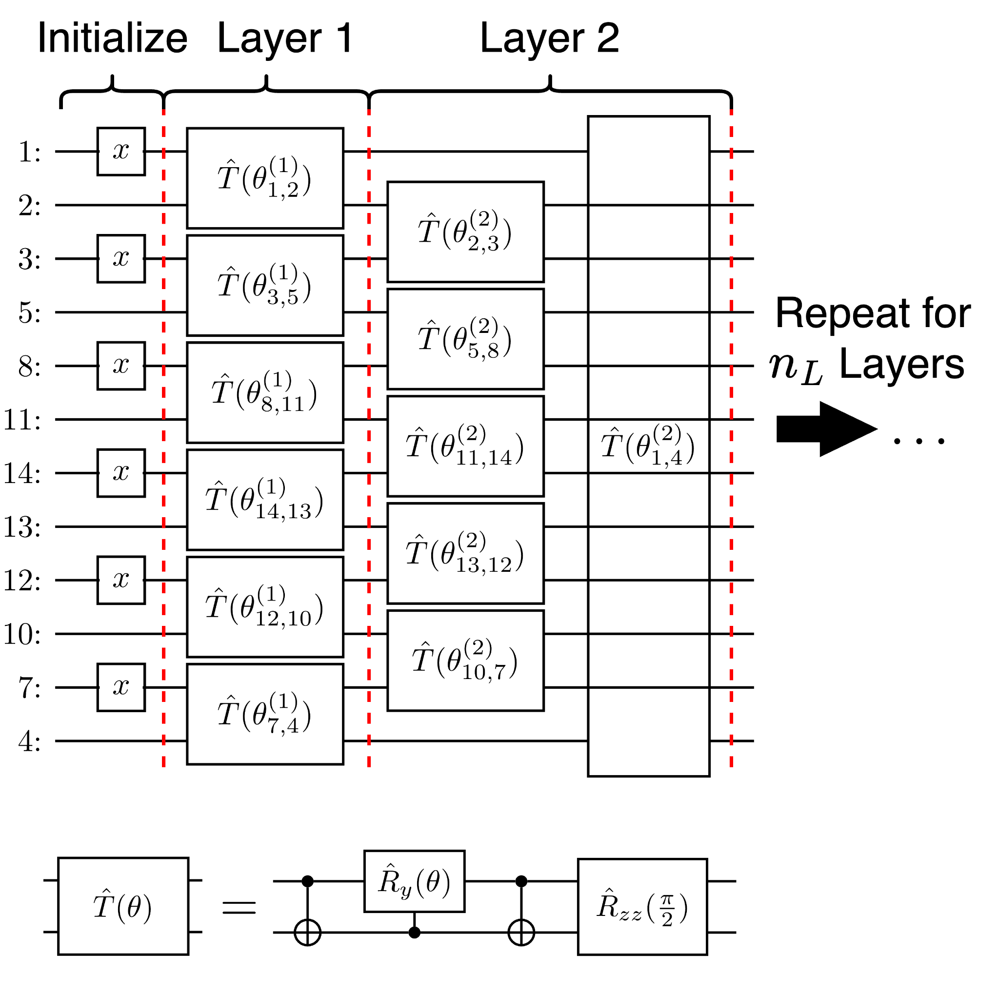
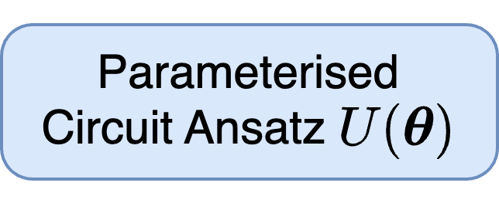
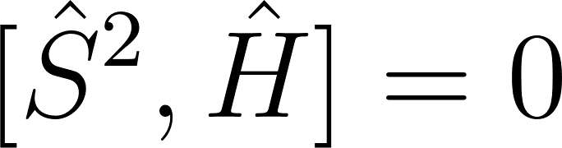
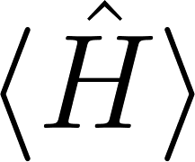
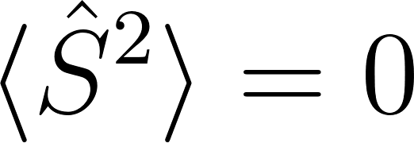
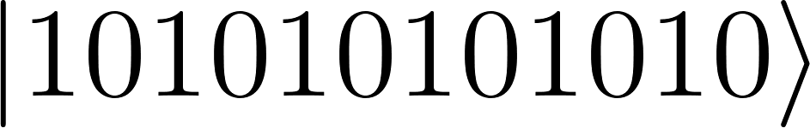
Circuit Ansatz
Observe that:
, total spin is conversed.
If is minimised, then is also minimised.
Our Ansatz:
Initialize circuit .
Apply single qubit excitations with additional R_{ZZ} gates to preserve total spin and add correlations. (Phys. Rev. A 102, 062612 (2020) & Quantum Sci. Technol. 4, 045005 (2019))
Single Qubit Excitation Gate with R_{ZZ} Gate
Notes:
# Hardware efficient ansatz that is spin preserving.
# Taken from https://arxiv.org/pdf/2005.14475.pdf but with additional ZZ-int
Rotosolve
The algorithm is described in further detail in Vidal and Theis (2018), Nakanishi, Fujii and Todo (2019), Parrish et al. (2019), and Ostaszewski et al. (2019), and the reconstruction method used for more general operations is described in Wierichs et al. (2022).

Slide 6
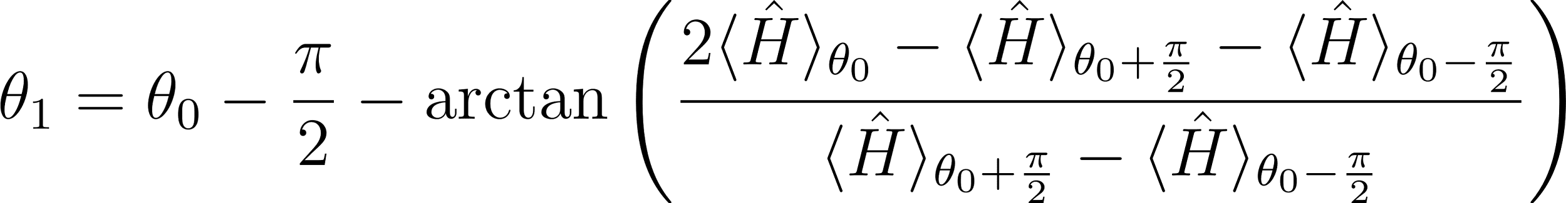
Optimizer
Rotoscope Optimization (Quantum 5, 391 (2021))
In one optimization iteration:
Update every parameter θ one by one, all else fixed.
Update example: θ₀ → θ₁
.

Slide 7

Strategies to reduce error
Hardware Efficient Ansatz
Ring Circuit Topology
No long range qubit gates
Classical Pre-optimization
To find minimum no. of layers, n_{L}=4
Overall Two Qubit Gate Depth of ansatz = 16
Qiskit Built-in Tools
Circuit Transpilations (optimization_level=3 ??)
Twirled Readout Error Extinction (resilience_level = 1??)
Custom Error Mitigation (PRX Quantum 3, 040318 (2022))
Rescale ground state energy estimate by

Slide 8


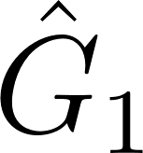
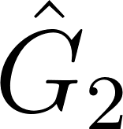
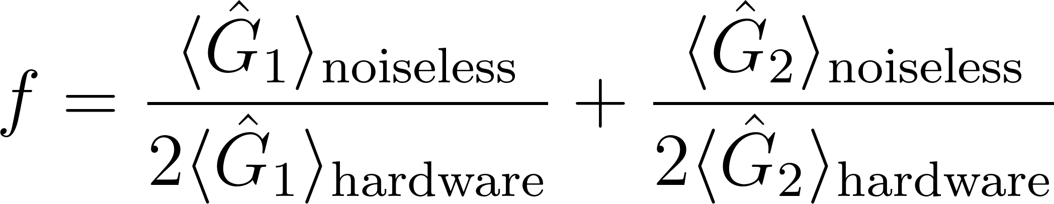
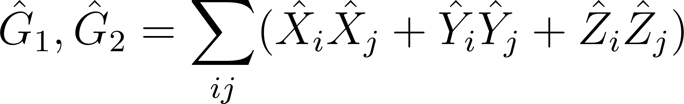
Custom Error Mitigation
Estimate ground state energy of trivial hamiltonians and using the same ansatz on ibmq_guadalupe.
Get rescaling factor
(PRX Quantum 3, 040318 (2022))

Slide 9
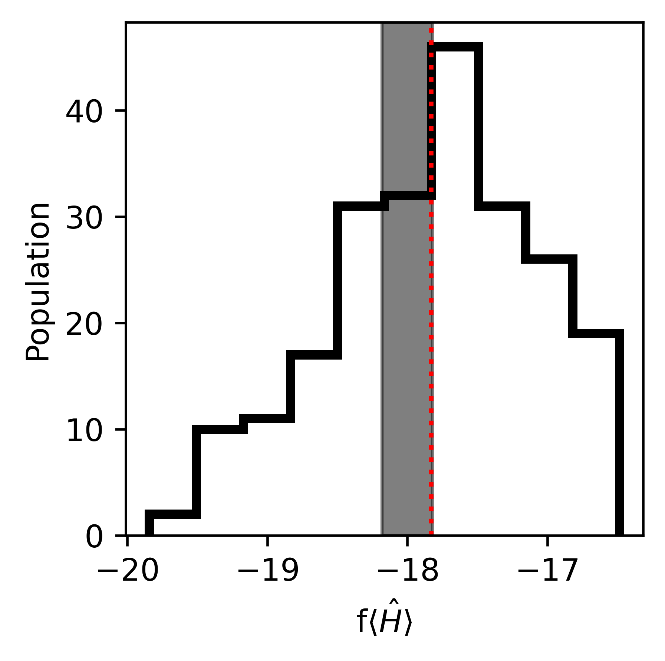
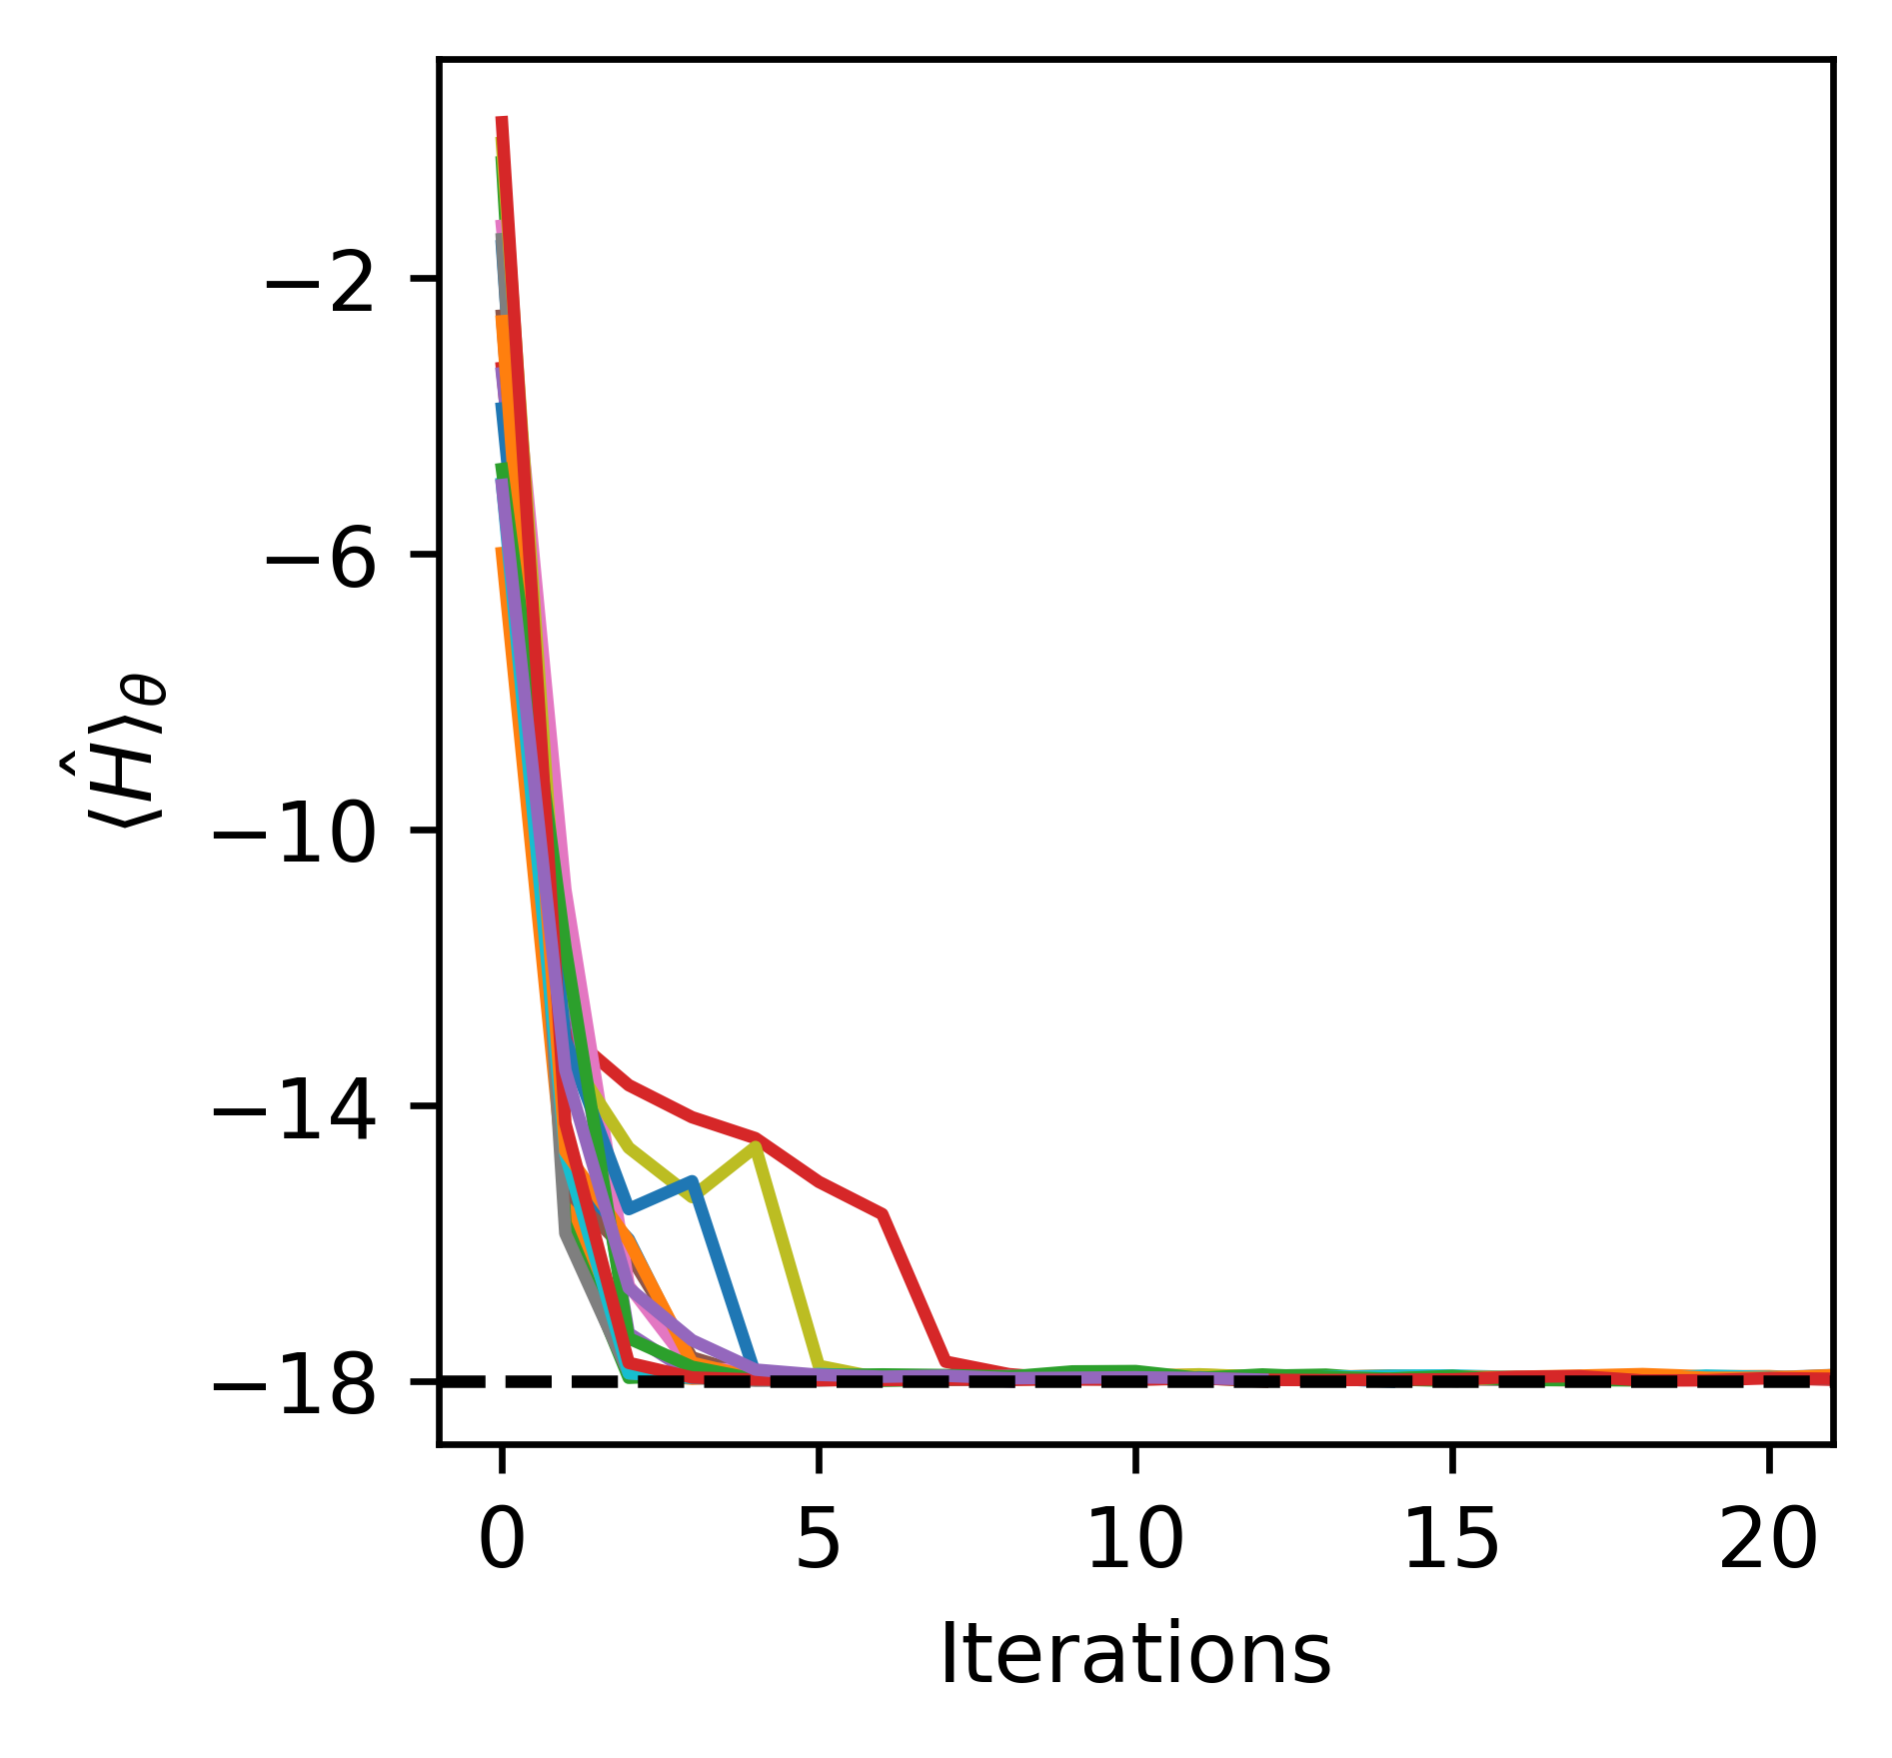
Implementation Results
-18±1%
Mean:-17.8±0.7
Fake Noisy IBM Guadalupe
(15 Independent VQE Runs each):
Average <H> :-9.5 ±1.2
Average f : 1.80±0.16
Average f<H> :-17.8±0.7

Slide 10
Scalability
For larger Kagome systems with more qubits,
Circuit Ansatz
Gate depth increases proportionally, so that qubit excitations are sufficiently scrambled.
Rotosolve and Qiskit Built-in Tools
Total no. of shots needed and optimization time increase proportionally to no. of parameters.
Rescaling Error Mitigation
Obtaining rescaling factor is a constant multiple of the computation time
Constant: no. of trivial hamiltonians required to solve.

Slide 11
Conclusion
We implemented a scalable optimizer, ansatz, and error mitigation technique for the kagome Hamiltonian.
We obtain within 1% of the ground state energy on the Fake IBM Guadalupe Device.
Unfortunately, due to queuing issues, we are unable obtain results for the real IBM Guadalupe Device.
However, we are confident that our method works.

